Slide 1
Face Anti-Spoofing
BTech Project Presentation
By: Tadi Dinesh Kumar Reddy (200001075)
Under supervision of: Dr. Surya Prakash

Slide 2
Recap

Slide 3
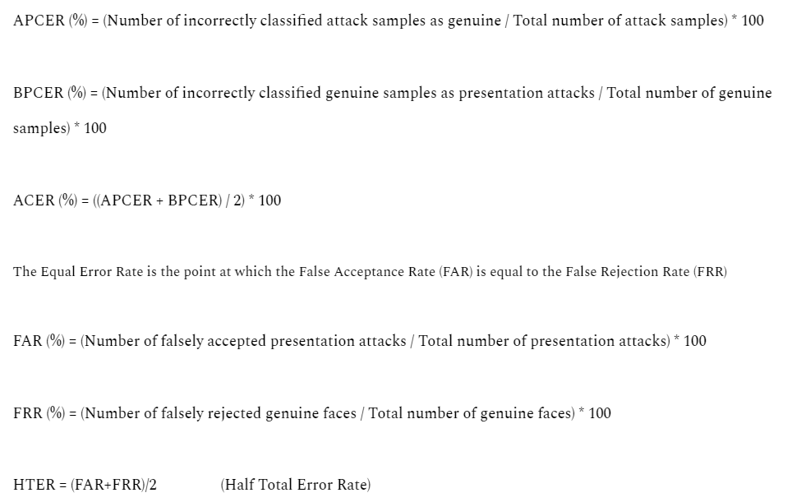
Metrics used for Face Anti-Spoofing

Slide 4
Searching Central Difference Convolutional Networks for Face Anti-Spoofing
Datasets used in paper
OULU-NPU, SiW, CASIA-MFSD, Replay-Attack, MSU-MFSD and SiW-M datasets used
Paper:
https://openaccess.thecvf.com/content_CVPR_2020/papers/Yu_Searching_Central_Difference_Convolutional_Networks_for_Face_Anti-Spoofing_CVPR_2020_paper.pdf

Slide 5
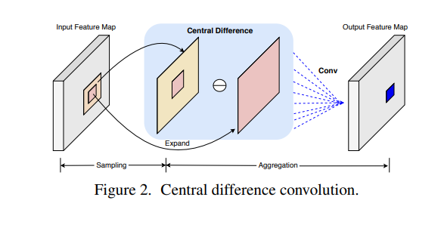
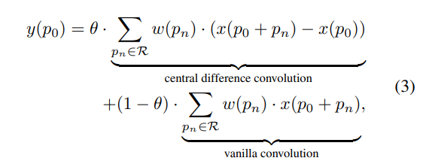
Searching Central Difference Convolutional Networks for Face Anti-Spoofing
CDC implementation:
For face anti-spoofing task,
both the intensity-level semantic info,
gradient-level detailed info are
crucial for distinguishing
the living and spoofing faces
So, a more generalized formula would be

Slide 6
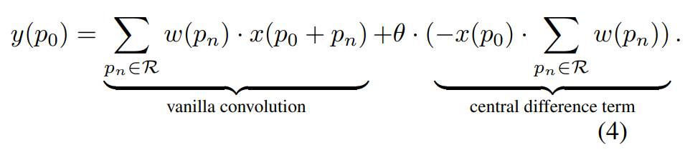

Searching Central Difference Convolutional Networks for Face Anti-Spoofing
CDC implementation:

Slide 7
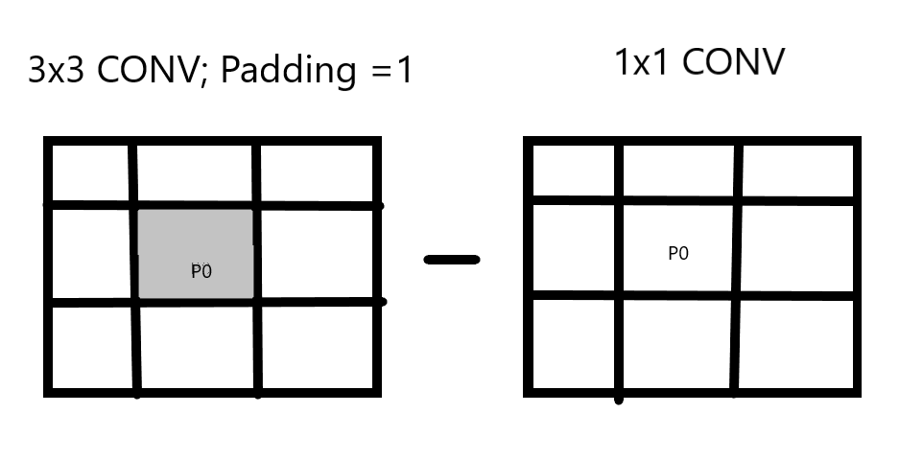
Searching Central Difference Convolutional Networks for Face Anti-Spoofing
CDC implementation:

Slide 8
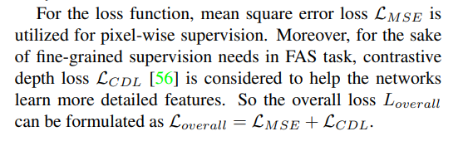
Searching Central Difference Convolutional Networks for Face Anti-Spoofing
Loss function
A 32x32 depth map is used for the pixel-wise supervision.
(All 1’s for genuine and all 0’s for attack)

Slide 9
Searching Central Difference Convolutional Networks for Face Anti-Spoofing
Pixel-wise Binary Supervision:
Well-suited for tasks where obtaining precise depth information for each pixel is crucial.
Can be effective in scenarios where absolute depth values are important, such as in robotics or autonomous navigation.
May struggle in situations with textureless or low-contrast regions, where it's challenging to obtain accurate depth information.
Contrast Depth Supervision:
Effective in tasks where relative depth information is more important than absolute values, such as in stereo vision.
Can provide more robustness in scenarios with textureless or low-contrast regions, as it relies on relative differences.
May not be as precise in scenarios where absolute depth values are critical.

Slide 10
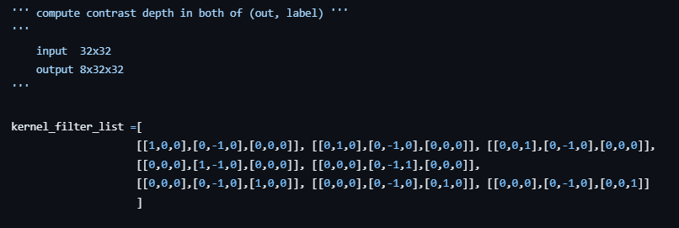
Searching Central Difference Convolutional Networks for Face Anti-Spoofing
Contrast Depth Loss Implementation:
A simple convolution with the above kernel is performed, giving an output designed to detect specific features in an image.
Vertical Edge Detection, Horizontal Edge Detection, Diagonal Edge Detection, Vertical Line Detection, Line Detection (45-degree Angle), Corner Detection, Spot Detection
The above output is then used to compute the contrastive depth loss (using MSE) and added to Pixel wise binary supervision loss (also using MSE) to compute the total loss for training the model.

Slide 11
Deep Pixel-wise Binary Supervision for Face Presentation Attack Detection
Datasets used
Replay-Mobile and OULU-NPU datasets were used
Paper:
https://ieeexplore.ieee.org/stamp/stamp.jsp?tp=&arnumber=8987370

Slide 12
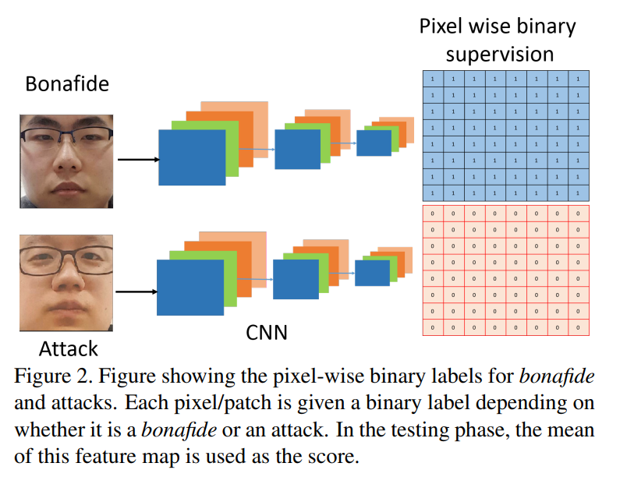
Deep Pixel-wise Binary Supervision for Face Presentation Attack Detection

Slide 13
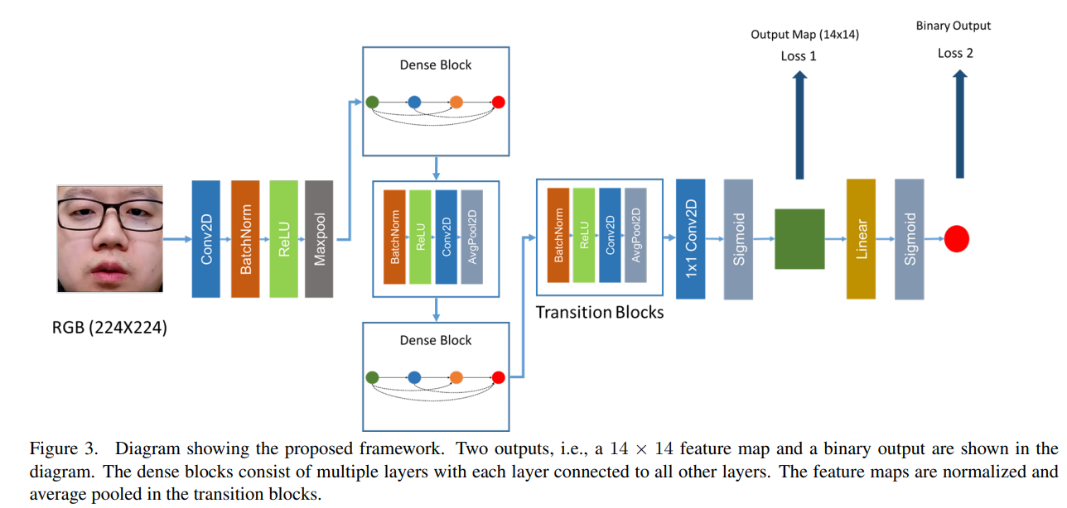
Deep Pixel-wise Binary Supervision for Face Presentation Attack Detection

Slide 14
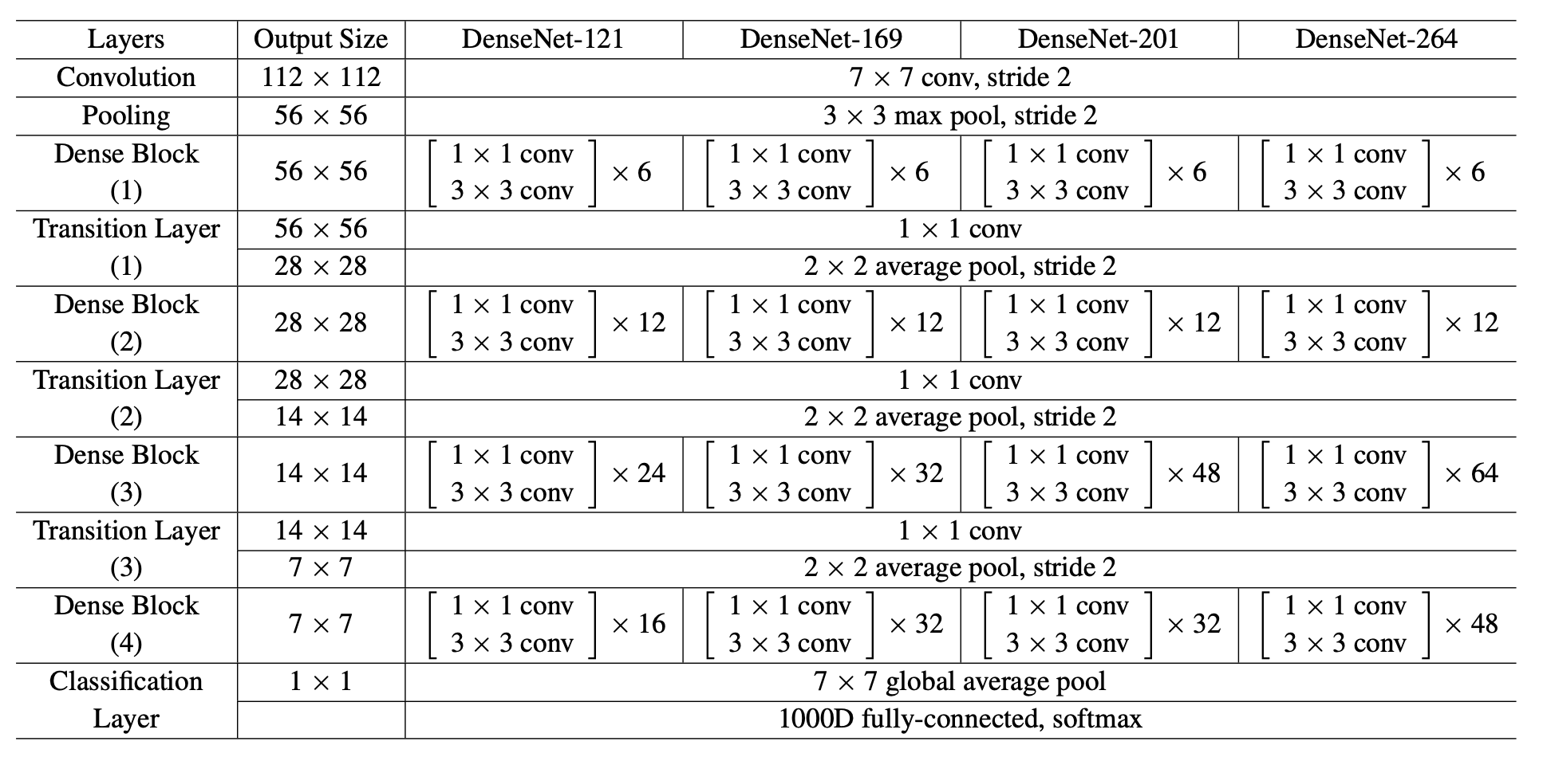
Deep Pixel-wise Binary Supervision for Face Presentation Attack Detection
Image reference: https://pytorch.org/hub/pytorch_vision_densenet/

Slide 15
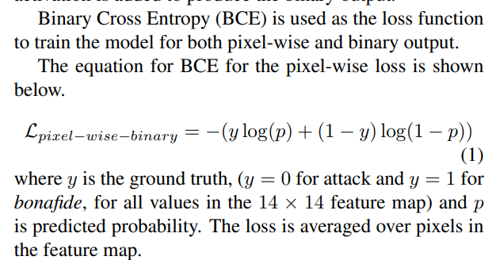
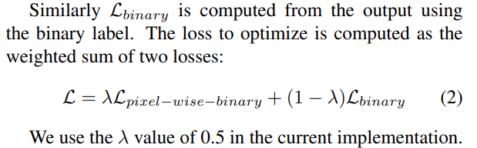
Deep Pixel-wise Binary Supervision for Face Presentation Attack Detection
Binary loss (Bona fide or PA)
Loss 2 in architecture shown
Pixel-wise-binary loss (depth loss)
Loss 1 in architecture shown

Slide 16
On the Effectiveness of Vision Transformers for Zero-shot Face Anti-Spoofing
Datasets used
HQ-WMCA and SiW-M datasets used
Paper:
https://ieeexplore.ieee.org/stamp/stamp.jsp?tp=&arnumber=9484333

Slide 17
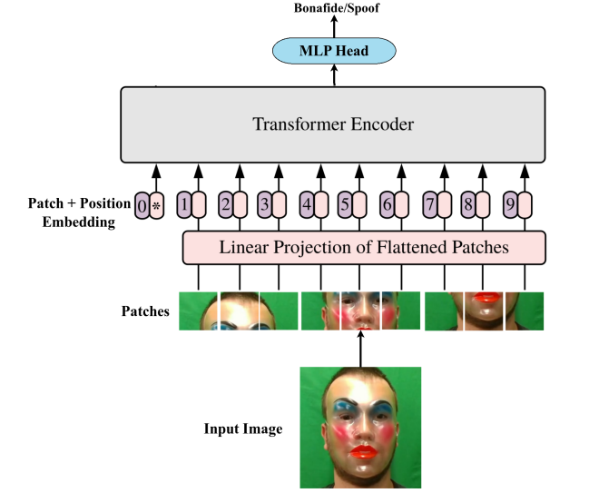
On the Effectiveness of Vision Transformers for Zero-shot Face Anti-Spoofing
ViT used : https://github.com/google-research/vision_transformer
(https://arxiv.org/abs/2010.11929)
The last layer is replaced with a
fully connected layer with one output node
and the model is fine-tuned using BCE loss.
The training and evaluation components
were implemented using the Bob2 library.

Slide 18
On the Effectiveness of Vision Transformers for Zero-shot Face Anti-Spoofing
For training, the pre-trained vision transformer model is taken and the final classification head is removed.
A new fully connected layer is added on top of the embedding followed by a sigmoid layer and trained with BCE loss.
“Adapting only the FC layer achieves the best results.”
Self-attention as opposed to convolutions helps to attend to all pairwise interactions in the lower layers.

Slide 19
Dataset

Slide 20
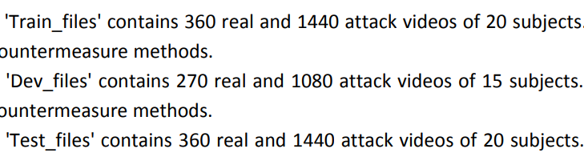
OULU-NPU dataset and preprocessing
A mobile face presentation attack database with real-world variations
4950 real access and attack videos that were
recorded using front facing cameras of six different smartphones
video length was limited to five seconds
Dataset Link: https://sites.google.com/site/oulunpudatabase/

Slide 21
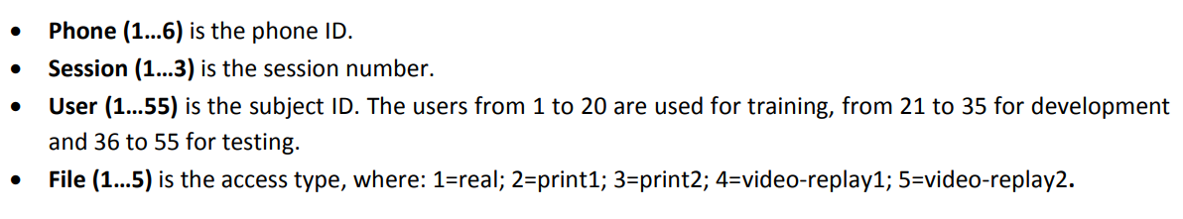
OULU-NPU dataset and preprocessing
In addition to the video files, the eye locations for each video is also given as text files
num_frame, x_eye_left, y_eye_left, x_eye_right, y_eye_right

Slide 22
OULU-NPU dataset and preprocessing
For each subject we have 5 files
1 - real
2,3 - print attacks (printed photo on a paper was fixed or hand-held)
4,5 - replay attacks (a recording of the person in a device was fixed or hand-held)

Slide 23
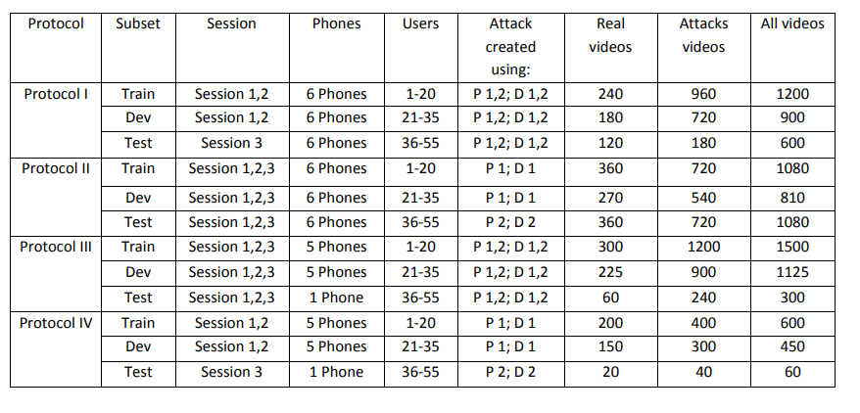
OULU-NPU dataset and preprocessing
4 evaluation protocols, usually used in papers using this dataset

Slide 24
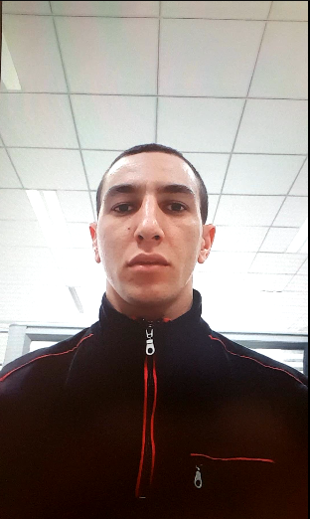
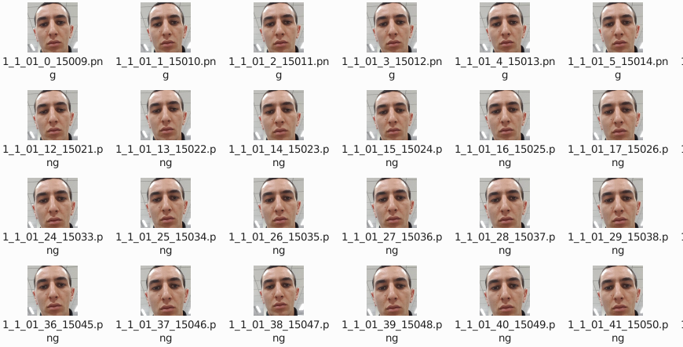
OULU-NPU dataset and preprocessing
Example from dataset What we finally need
1_1_01_1.avi

Slide 25
OULU-NPU dataset and preprocessing
Typically we use a fixed frame division rate (near to the video’s frame rate) to split the video files into images. (number of frames in video ranging in ~500-1000)
But in this case we have txt files with eye coordinates for each frame of the video
So we can instead get the exact frames from the txt file (avoids duplicates)
We need to apply face detection algorithm on each image/frame
Because we don’t want pixel information from the surroundings to affect our training process.
Opencv’s Haar Cascade Classifier is used

Slide 26
OULU-NPU dataset and preprocessing
Options for face detection algorithms were (pretrained)
Haar Cascades, MTCNN, Dlib's Face Detector, YOLO, LBP, etc.
Choosing the right model is a trade off between speed, accuracy and flexibility.
Haar cascades are generally considered one of the fastest methods for face detection.
Haar-like features are simple, rectangular filters used in the Haar cascade object detection they are edge or line detection features used to make the face detections
While it may not be as accurate as MTCNN or YOLO it is much faster
Upon testing MTCNN although available through python’s MTCNN library is very slow.
Others are slightly time consuming to implement or slow.
Haar cascades also captures more area than Dlib and is also more flexible.

Slide 27
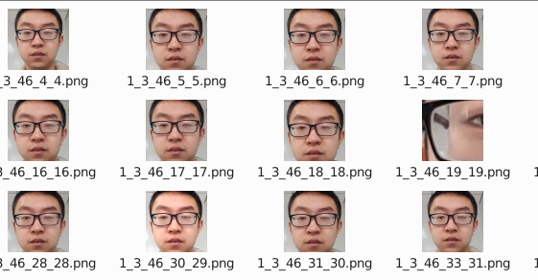
OULU-NPU dataset and preprocessing
Haar Cascades was the best available option that could handle the processing in a short time for such a large dataset (OULU-NPU is around 95 Gb) and flexible enough to test for the best hyperparameters and capture a large portion of the face.
But disadvantage was accuracy (Anomalies as shown below or no detections in image)

Slide 28
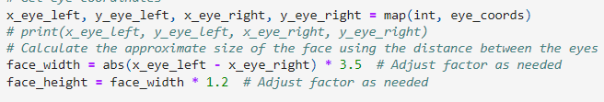
OULU-NPU dataset and preprocessing
We can use the eye coordinates in each frame to get an estimate of the face region.
Through extensive testing we can get the right hyperparameters that give least number of anomalous detections.

Slide 29
OULU-NPU dataset and preprocessing
Haar Cascades:
faces = face_cascade.detectMultiScale(gray_eyes, scale_factor, min_neighbors)
scale_factor and min_neighbors are two hyperparameters important for making proper detections in a given frame. (used a customized setting for this as well)
Scale_factor: parameter that compensates for objects appearing smaller the farther they are from the camera. When an image is processed at multiple scales, it helps in detecting objects of different sizes in the image. It specifies how much the image size is reduced at each image scale when searching for objects (ranges between 1.01 & 1.5)
Min_neighbors: parameter specifies how many neighbors (bounding boxes) a region needs to have in order to be considered a valid detection.

Slide 30



OULU-NPU dataset and preprocessing
The entire pre-processing gave:
Train:
Dev:
Test:

Slide 31
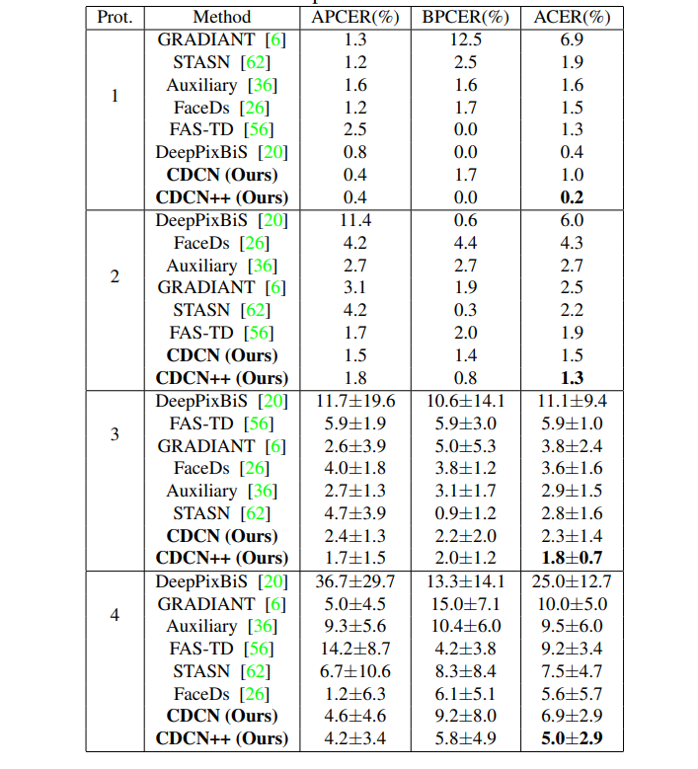
CDCN and Deep Pixel wise Binary Supervision(Densenet) metrics on OULU-NPU

Slide 32
New Models

Slide 33
CDC-DenseNet

Slide 34

DenseNet with CDCN
Replaced the 3x3 kernel nn.conv2D operation with CDC operator
While leaving the 1x1 kernel operations as normal.
Modified the Densenet-161 architecture from Pytorch official Github page (https://github.com/pytorch/vision/blob/main/torchvision/models/densenet.py#L251)
Ran code by modifying and using the training code from CDCN code

Slide 35
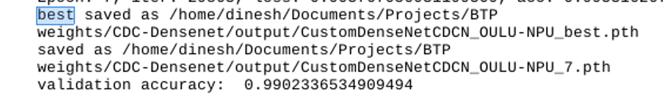
DenseNet with CDCN
Training loss and accuracy: OULU-NPU (best val accuracy after 8 epochs)

Slide 36

DenseNet with CDCN
Test metrics: OULU-NPU after 8 epochs

Slide 37
DenseNet-ViT with Pixel Wise Binary Supervision

Slide 38
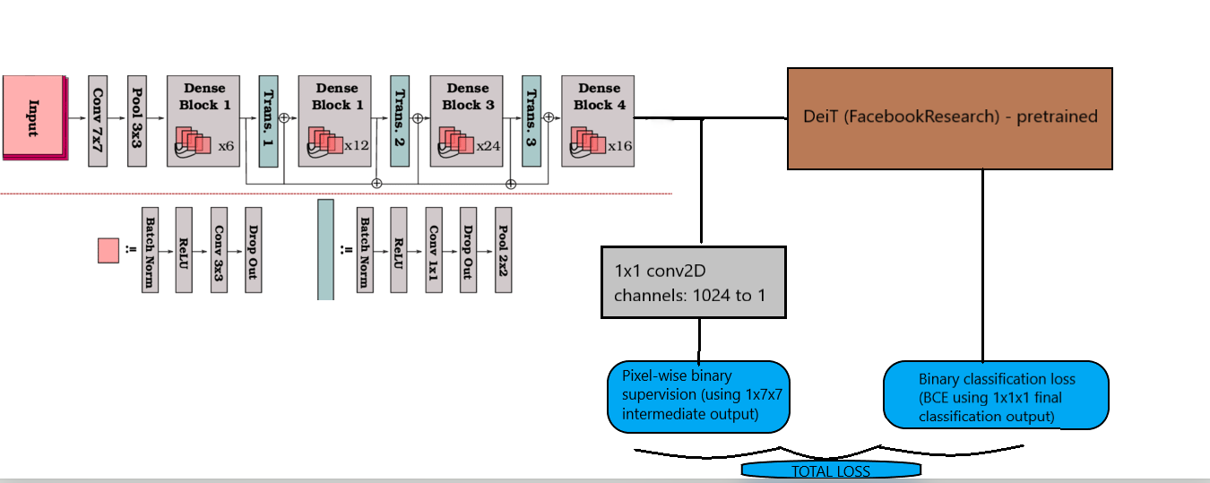
ViT(Deit) with Densenet backbone using Pixel wise binary supervision
Model Diagram
Densenet121 backbone

Slide 39
ViT(Deit) with Densenet backbone using Pixel wise binary supervision
Why DeiT was chosen
DeiT introduces a more efficient attention mechanism compared to the original ViT
DeiT is specifically designed to be data-efficient. It demonstrates strong performance with fewer training samples compared to some other ViT models.
One of the main advantages of the DeiT (Data-efficient Image Transformer) architecture is its efficiency in terms of the number of parameters compared to some other ViT (Vision Transformer) models.
In tasks where computational resources, memory constraints, or training data availability are limited, the data efficiency of DeiT can be a significant advantage
Also the availability and usability of the pretrained DeiT models was a large factor.

Slide 40
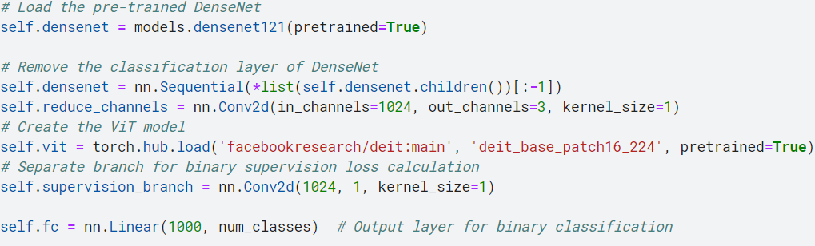
ViT(Deit) with Densenet backbone using Pixel wise binary supervision
We are using the pretrained Densenet121 and DeiT (Data-efficient Image Transformer)
With the densenet being used as the backbone

Slide 41
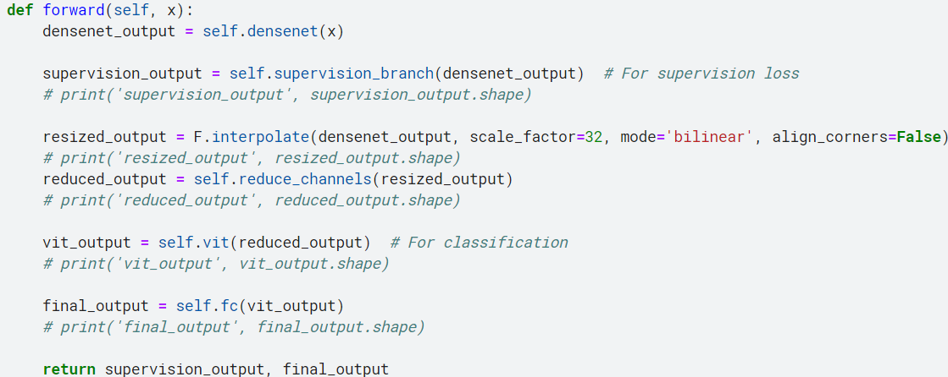
ViT(Deit) with Densenet backbone using Pixel wise binary supervision
The intermediate outputs from backbone are used for Pixel wise binary supervision
And the final output from the ViT is used for binary classification.

Slide 42
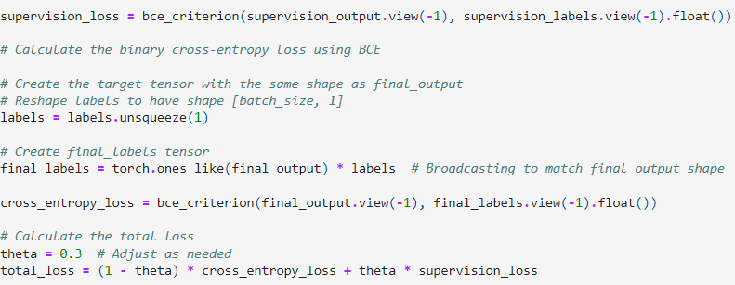
ViT(Deit) with Densenet backbone using Pixel wise binary supervision
Loss function: Total loss denoted with a weighted average of the
final binary classification loss (BCE loss) and pixel-wise binary supervision loss (BCE loss)

Slide 43
ViT(Deit) with Densenet backbone using Pixel wise binary supervision
From Replay-attack
Observed that using BCE loss for both losses was better converging as compared to using
MSE for Pixel wise binary supervision loss and
BCE for Classification loss
Theta of 0.3 was an optimal choice using Replay-attack

Slide 44
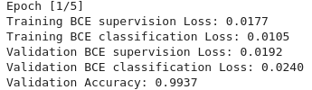
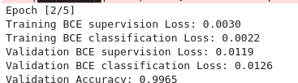
ViT(Deit) with Densenet backbone using Pixel wise binary supervision
Training loss and accuracy: OULU-NPU
Tried to decay learning rate after 2 epochs by 0.1 but was starting to overfit even then
(More testing required)

Slide 45
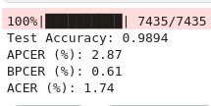
ViT(Deit) with Densenet backbone using Pixel wise binary supervision
Test metrics: OULU-NPU after 2 epochs

Slide 46
References
Links
https://github.com/ZitongYu/CDCN/tree/master
https://github.com/laoshiwei/face-anti-spoofing
https://gitlab.idiap.ch/bob/bob.paper.deep_pix_bis_pad.icb2019
https://github.com/Saiyam26/Face-Anti-Spoofing-using-DeePixBiS
https://ieeexplore.ieee.org/stamp/stamp.jsp?tp=&arnumber=8987370
https://openaccess.thecvf.com/content_CVPR_2020/papers/Yu_Searching_Central_Difference_Convolutional_Networks_for_Face_Anti-Spoofing_CVPR_2020_paper.pdf
http://parnec.nuaa.edu.cn/_upload/tpl/02/db/731/template731/pages/xtan/NUAAImposterDB_download.html
https://www.researchgate.net/publication/334170752_Leveraging_Sparse_and_Dense_Features_for_Reliable_State_Estimation_in_Urban_Environments
https://ieeexplore.ieee.org/stamp/stamp.jsp?arnumber=9484333
https://github.com/pineapple45/anti-face-spoofing-techniques/blob/master/Siamese-Network-Anti-spoofing/DataGeneration.ipynb

Slide 47
Dataset References
Dataset Papers
https://sites.google.com/site/oulunpudatabase/
Z. Boulkenafet, J. Komulainen, L. Li, X. Feng and A. Hadid, "OULU-NPU: A Mobile Face Presentation Attack Database with Real-World Variations", 12th IEEE International Conference on Automatic Face & Gesture Recognition (FG 2017), 2017, pp. 612-618, doi: 10.1109/FG.2017.77.
https://www.idiap.ch/en/dataset/replayattack
Chingovska, A. Anjos, S. Marcel,"On the Effectiveness of Local Binary Patterns in Face Anti-spoofing"; IEEE BIOSIG, 2012.

Slide 48
References
Papers
Yu, Zitong, et al. "Searching central difference convolutional networks for face anti-spoofing." Proceedings of the IEEE/CVF Conference on Computer Vision and Pattern Recognition. 2020.
George, Anjith, and Sébastien Marcel. "Deep pixel-wise binary supervision for face presentation attack detection." 2019 International Conference on Biometrics (ICB). IEEE, 2019.
George, Anjith, and Sébastien Marcel. "On the effectiveness of vision transformers for zero-shot face anti-spoofing." 2021 IEEE International Joint Conference on Biometrics (IJCB). IEEE, 2021.

